Slide 1
Chapter 2 Heuristics and Metaheuristics
吕志鹏
教授，博士生导师
计算科学理论研究所 常务副所长
华中科技大学 计算机科学与技术学院

Slide 2
Heuristics and Metaheuristics

Slide 3
Heuristics
Definition - educated guess, it’s originated in the old Greek word heuriskein: art of discovering new strategies(rules) to solve problems
When you use a heuristic to solve a problem, you have a gut feeling that it is a pretty good solution, but can not prove it mathematically
You can not prove that there is not a better solution out there.

Slide 4
Metaheuristics
The suffix meta also a Greek word: upper level methodology.
Introduced by Dr. Fred Glover in 1986
Metaheuristic: Upper level general methodology (templates) that can be used as guiding strategies in designing underlying heuristics to solve specific optimization problems.
Relationship between heuristics and metaheuristics.

Slide 5
Types of Metaheuristics (1)
Single Solution Algorithms (S):
  Common concepts for S-metaheuristics
  Local search
  Advanced local search

Slide 6
Types of Metaheuristics (2)
Population Based Algorithms (P):
  Common concepts for P-metaheuristics
  Evolutionary algorithms
Hybrid Algorithms (H):
  Memetic algorithm: LS + GA

Slide 7
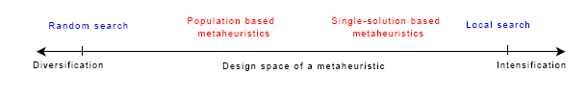
Metaheuristic Design
No “Super Method” for all problems (NFL Theorem)
  Exploration / Exploitation
  Intensification / Diversification

Slide 8
Classification of Metaheuristic
Nature inspired/ Non nature inspired
Memory usage / Memory less
Deterministic/ Stochastic
Population based/ Single-solution based
Iterative/ Greedy
Dynamic vs. static objective function
One vs. various neighborhood structures

Slide 9
S-Metaheuristics

Slide 10
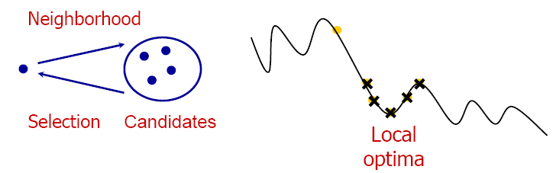
Single solution-based metaheuristics
“Improvement” of a single solution; Walks through neighborhoods or search trajectories in the landscape
Iterative exploration of the neighborhood. (intensification)
All LS algorithms differ from each other in two aspects:
  neighborhood definition → where can we go?
  search strategy → where do we go?

Slide 11
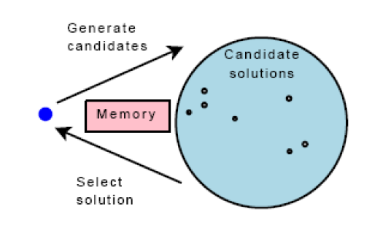
Main Principle of S-metaheuristics
Main principles of single solution-based metaheuristics

Slide 12
Template of LS Algorithms
Generate initial solution x0
Repeat
  Construct the neighborhood of x0, denoted by N(x0)
  Select the best candidate solution x1 in N(x0)
  x0 ← x1
Until (stopping criterion is met)

Slide 13
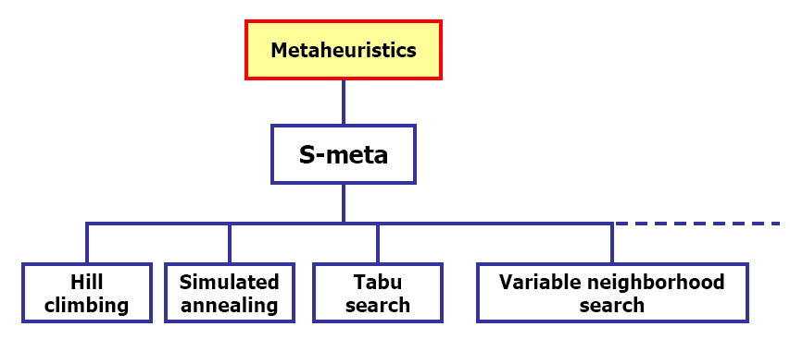
Taxonomy of S-metaheuristics

Slide 14
Outline of S-metaheuristics
Common concepts for S-metaheuristics
  Neighborhood
  Initial solution
  Incremental evaluation of neighbors
Advanced Local Search
  Iterative local search
  Tabu Search
  Simulated Annealing
  Variable Neighborhood search

Slide 15
Neighborhood

Slide 16
Neighborhood
Neighborhood: is defined by all the candidate solutions incurred by one single move on the current solution:
Principle of Neighborhood Definition:
  Binary Problems: one-flip (simplest is the best)
  Grouping Problems: one-move, two-swap, Kemp chain
  Scheduling Problems: permutation represents a priority queue. The relative order in the sequence is important.
  Routing Problems: adjacency of the element is important.

Slide 17
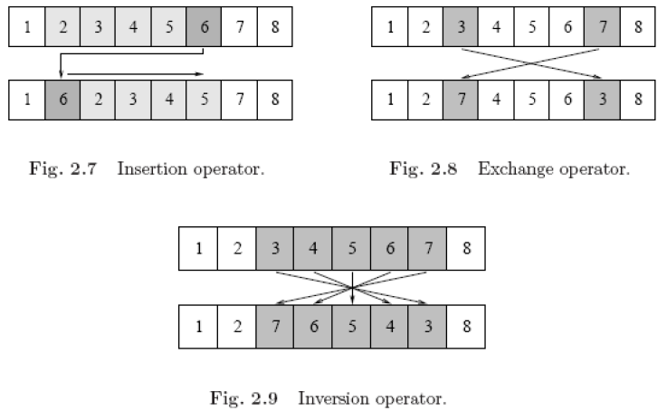
Permutation Neighborhood
Insertion, exchange and inversion neighborhoods:

Slide 18
Initial solution
Two main strategies:
  Random solution
  Heuristic solution (e.g. Greedy Constructive Heuristic)
Tradeoff: quality–computational time
Using better initial solutions will not always lead to better local optima solution
Generally to speak, its importance depends on the search power of local search algorithm

Slide 19
Incremental evaluation of neighborhood
Very Important!
Evaluation of a solution: Most expensive part of a metaheuristic. One should quickly determine the incremental value of the objective function for each candidate solution.
Naïve evaluation: complete evaluation of every solution of the neighborhood

Slide 20
Local Search

Slide 21
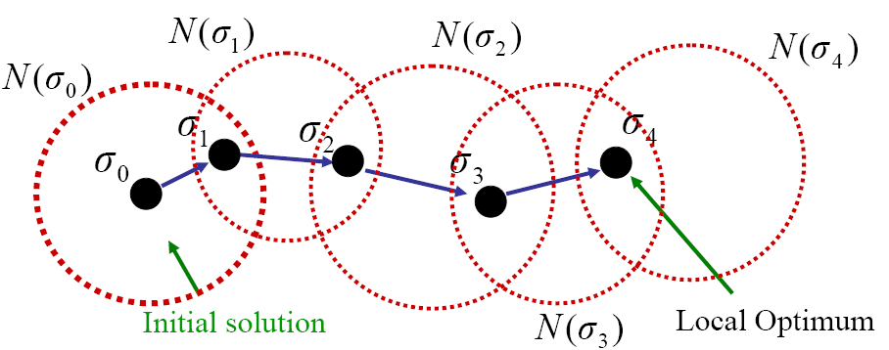
Local Search-Hill Climbing
Oldest and simplest S-metaheuristic method
Hill-climbing, descent, iterative improvement, and so on
Replaces the current solution with an improving one

Slide 22
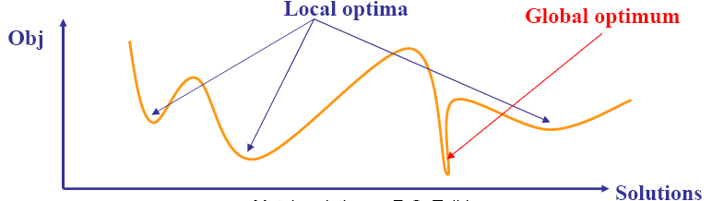
Local Search
Easy to implement.
It only leads to local optima.
The found optima highly depends on the initial solution.

Slide 23
Selection of the neighbor
Best improvement: Deterministic/full -choosing the best neighbor (i.e. that improves the most the objective function).
First improvement: Deterministic/partial -choosing the first processed neighbor that is better than the current solution.

Slide 24
Advanced Local Search

Slide 25
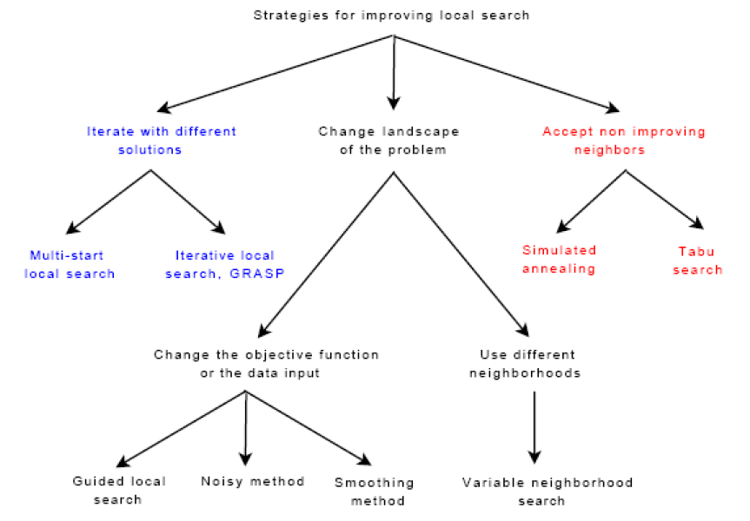
Advanced local search
Escape from local optima

Slide 26
Iterated Local Search

Slide 27
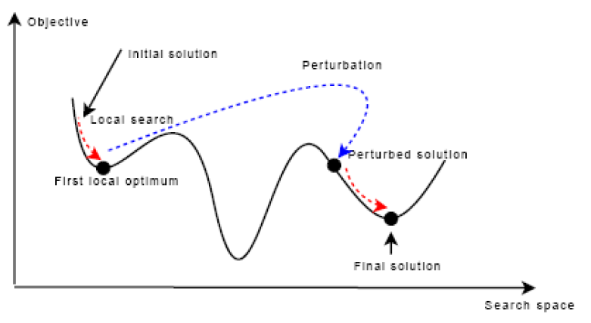
Iterated Local Search

Slide 28
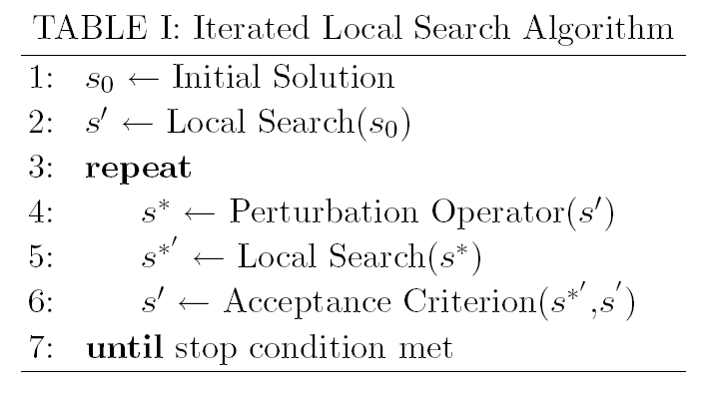
Template of ILS Algorithms

Slide 29
Tabu Search

Slide 30
Tabu Search
Proposed by Dr. Fred Glover (1986)
It behaves like Hill Climbing algorithm
But it accepts non-improving solutions in order to escape from local optima (where all the neighboring solutions are non-improving)
Deterministic algorithm

Slide 31
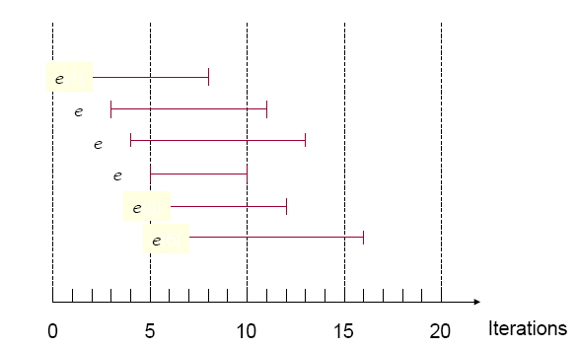
Tabu Search Illustration

Slide 32
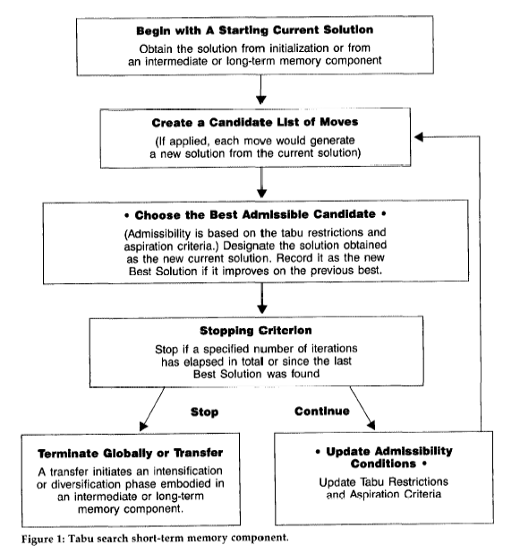
Template of TS Algorithms

Slide 33
Design questions
Tabu list (Short Term Memory)
  Attributive, not solution (expensive)
  Recency based
  Multiple tabu lists
  Tabutenure (length of tabu list)
Aspiration criterion: accepting tabu moves if it can override the best found solution found so far.
Medium term memory (Intensification): giving priority to attributes of a set of elite solutions
Long Term Memory (Diversification)
  Frequency-based

Slide 34
Simulated Annealing

Slide 35
Simulated Annealing
Mimics the physical annealing process (statistical mechanics).
Material is heated and slowly cooled towards a strong crystalline structure (instead of meta stable states)
The first SA algorithm was developed in 1953 (Metropolis).
Kirkpatrick, S , Gelatt, C.D., Vecchi, M.P. 1983. “Optimization by Simulated Annealing”. Science, vol 220, No. 4598, pp 671-680.

Slide 36
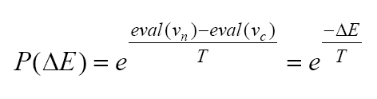
Simulated Annealing
SA allows downwards steps.
A move is selected at random and its acceptation is conditional (stochastic Boltzmann distribution)
Role of the temperature:
  T small : local search (end of the search)
  T large : random search (beginning of the search)

Slide 37
Template of SA Algorithms
Generate initial solution x0, T=T0
Repeat
  Construct the neighborhood of x0, denoted by N(x0)
  Randomly generate one candidate solution x1 in N(x0)
  x0 ← x1 with the probability
  Update temperature T
Until (stopping criterion is met)

Slide 38
Cooling Schedule
Main design questions:
  Initial temperature
    Not be too hot-random walk
    Hot enough-allow moves, else hill climbing
  Equilibrium state
    A sufficient number of moves at each temperature
  Cooling
    Compromise: quality / search time.
    Different strategies: linear, geometric, logarithmic, adaptive…

Slide 39
Variable Neighborhood Search

Slide 40
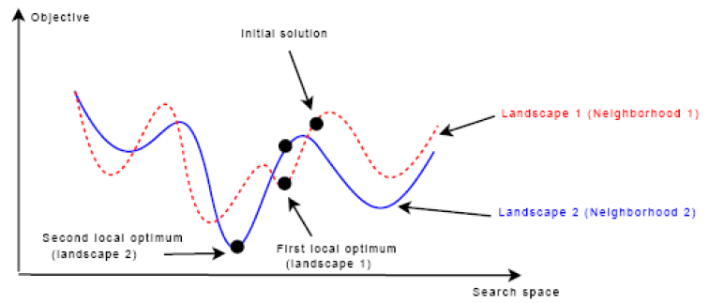
Variable Neighborhood Search

Slide 41
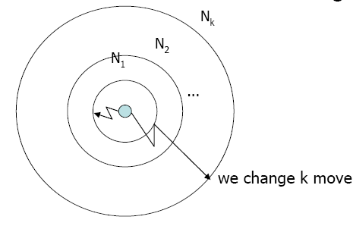
Variable Neighborhood Search
Different neighborhoods
  Ex: Nk → Neighborhood in k distance
Order of exploration
  Ex: Nk(x) → Set of solutions in the kth neighborhood of x.

Slide 42
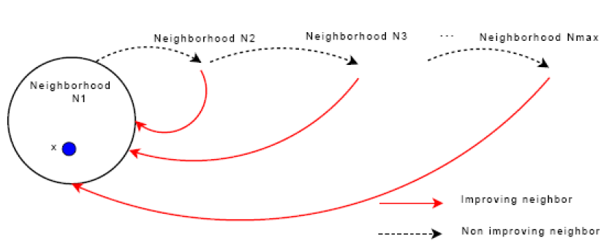
Variable Neighborhood Search
VNS ends when there is no improvement with the all neighborhoods
The final solution provided by the algorithm should be a local optimum with respect to all kmax neighbourhoods.

Slide 43
Population Based Metaheuristics

Slide 44
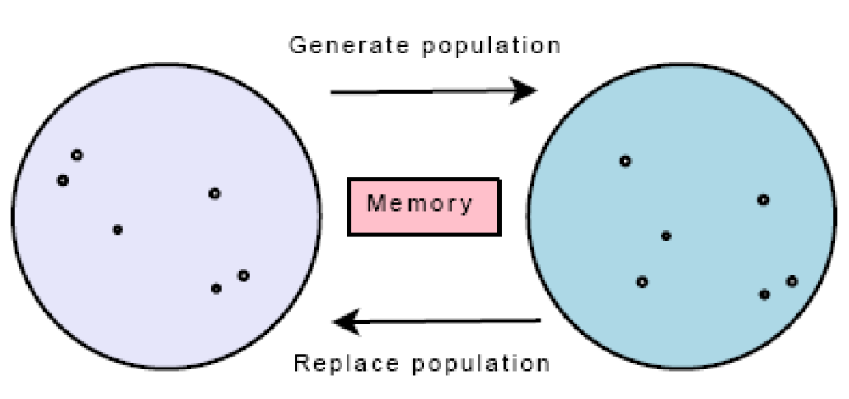
Template of P-metaheuristics

Slide 45
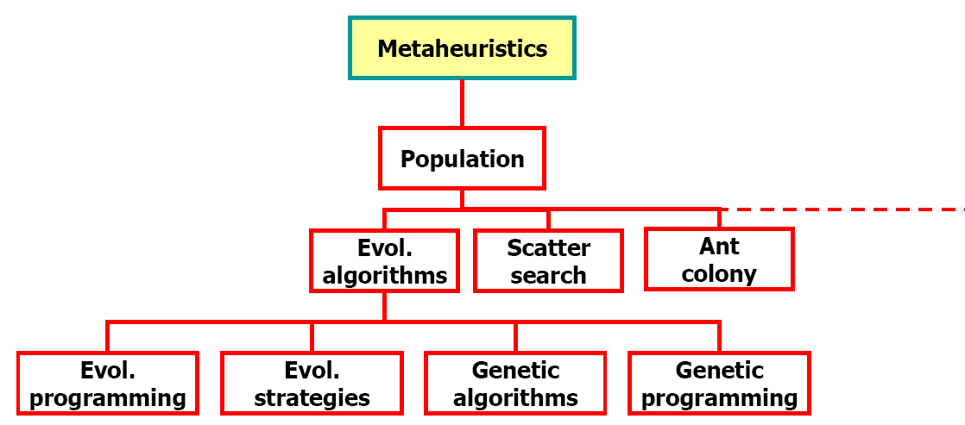
Taxonomy (Population-based Metaheuristics)
Single solution metaheuristics are Intensification oriented
Population-based metaheuristics are Diversification oriented

Slide 46
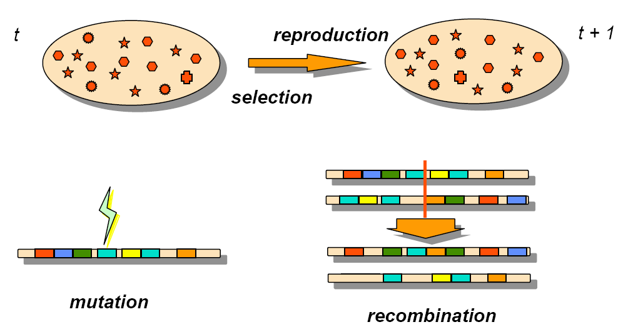
Main Components

Slide 47
Common search components for evolutionary algorithms
Selection strategies: which parents are selected for reproduction.
Reproduction strategies: Semantic crossover/mutation operators.---problem structure.
Replacement strategies: how the current population is updated according to the generated offsprings. How to maintain a healthy population to enhance the search.

Slide 48
Genetic Algorithm

Slide 49
Genetic Algorithms (GA) OVERVIEW
A class of probabilistic optimization algorithms
Inspired by the biological evolution process
Uses concepts of “Natural Selection” and “Genetic Inheritance” (Darwin 1859)
Originally developed by John Holland (1975)
Introduction to Genetic Algorithms

Slide 50
GA overview (cont)
Particularly well suited for hard problems where little is known about the underlying search space
Widely-used in business, science and engineering
Introduction to Genetic Algorithms

Slide 51
A genetic algorithm maintains a population of candidate solutions for the problem at hand, and makes it evolve by iteratively applying a set of stochastic operators
GA overview (cont)
Introduction to Genetic Algorithms

Slide 52
Stochastic operators
Selection replicates the most successful solutions found in a population at a rate proportional to their relative quality
Recombination decomposes two distinct solutions and then randomly mixes their parts to form novel solutions
Mutation randomly perturbs a candidate solution
Introduction to Genetic Algorithms

Slide 53
The Metaphor
Genetic Algorithm | Nature
Optimization problem | Environment
Feasible solutions | Individuals living in that environment
Solutions quality (fitness function) | Individual’s degree of adaptation to its surrounding environment
Introduction to Genetic Algorithms

Slide 54
The Metaphor (cont)
Genetic Algorithm | Nature
A set of feasible solutions | A population of organisms (species)
Stochastic operators | Selection, recombination and mutation in nature’s evolutionary process
Iteratively applying a set of stochastic operators on a set of feasible solutions | Evolution of populations to suit their environment
Introduction to Genetic Algorithms

Slide 55
Simple Genetic Algorithm
produce an initial population of individuals
evaluate the fitness of all individuals
while termination condition not met do
select fitter individuals for reproduction
recombine between individuals
mutate individuals
evaluate the fitness of the modified individuals
generate a new population
End while
Introduction to Genetic Algorithms

Slide 56
The Evolutionary Cycle
parents
selection
modification
modified
offspring
initiate &
population
evaluation
evaluate
evaluated offspring
deleted
members
discard
Introduction to Genetic Algorithms

Slide 57
Components of a GA
A problem definition as input, and
Encoding principles (gene, chromosome)
Initialization procedure (creation)
Selection of parents (reproduction)
Genetic operators (mutation, recombination)
Evaluation function (environment)
Termination condition
Introduction to Genetic Algorithms

Slide 58
Representation (encoding)
Possible individual’s encoding
  Bit strings (0101 ... 1100)
  Real numbers (43.2 -33.1 ... 0.0 89.2)
  Permutations of element (E11 E3 E7 ... E1 E15)
  ... any data structure ...
Introduction to Genetic Algorithms

Slide 59
Representation (cont)
When choosing an encoding method rely on the following key ideas
Use a data structure as close as possible to the natural representation
Write appropriate genetic operators as needed
If possible, ensure that all genotypes correspond to feasible solutions
If possible, ensure that genetic operators preserve feasibility
Introduction to Genetic Algorithms

Slide 60
Initialization
Start with a population of randomly generated individuals, or use
- A previously saved population
- A set of solutions provided by a human expert
- A set of solutions provided by another heuristic algorithm
Introduction to Genetic Algorithms

Slide 61
Selection
Purpose: to focus the search in promising regions of the space
Inspiration: Darwin’s “survival of the fittest”
Trade-off between exploration and exploitation of the search space
Next we shall discuss possible selection methods
Introduction to Genetic Algorithms

Slide 62
Local Tournament Selection
Extracts k individuals from the, where the probability for an individual to win is generally proportional to its fitness
Selection pressure is directly proportional to the number k of participants
Introduction to Genetic Algorithms

Slide 63
Recombination (Crossover)
* Enables the evolutionary process to move toward promising regions of the search space
* Matches good parents’ sub-solutions to construct better offspring
Introduction to Genetic Algorithms

Slide 64
One-point crossover 1
Randomly one position in the chromosomes is chosen
Child 1 is head of chromosome of parent 1 with tail of chromosome of parent 2
Child 2 is head of 2 with tail of 1

Slide 65
Reproduction Operators comparison
Single point crossover
→
Cross point
Two point crossover (Multi point crossover)
→

Slide 66
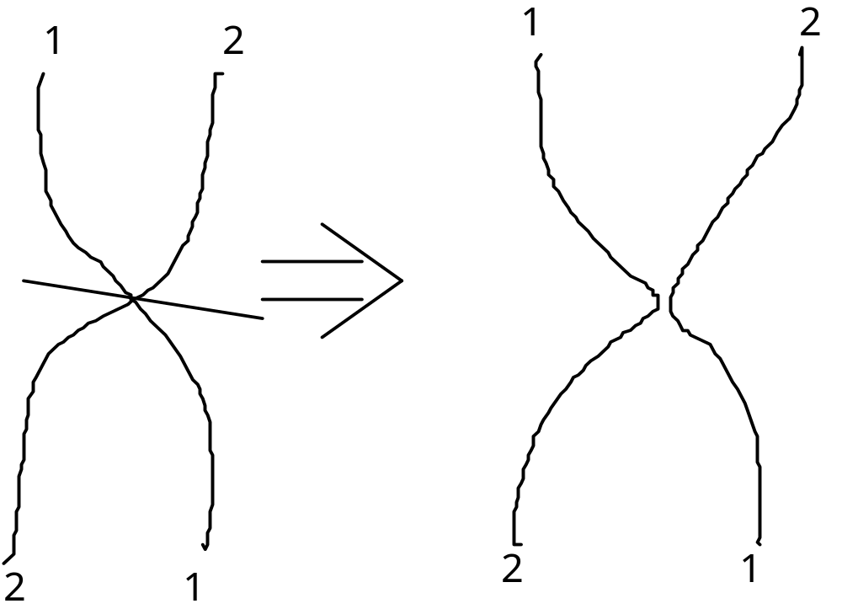
One-point crossover - Nature

Slide 67
Reproduction Operators
Uniform crossover
→
Is uniform crossover better than single crossover point?
  Trade off between
    Exploration: introduction of new combination of features
    Exploitation: keep the good features in the existing solution

Slide 68
Problems with crossover
Depending on coding, simple crossovers can have high chance to produce illegal offspring
  E.g. in TSP with simple binary or path coding, most offspring will be illegal because not all cities will be in the offspring and some cities will be there more than once
Uniform crossover can often be modified to avoid this problem
  E.g. in TSP with simple path coding:
    Where mask is 1, copy cities from one parent
    Where mask is 0, choose the remaining cities in the order of the other parent

Slide 69
Reproduction Operators
Mutation
  Generating new offspring from single parent
  Maintaining the diversity of the individuals
    Crossover can only explore the combinations of the current gene pool
    Mutation can “generate” new genes
→

Slide 70
Reproduction Operators
Control parameters: population size, crossover/mutation probability
  Problem specific
  Increase population size
    Increase diversity and computation time for each generation
  Increase crossover probability
    Increase the opportunity for recombination but also disruption of good combination
  Increase mutation probability
    Closer to randomly search
    Help to introduce new gene or reintroduce the lost gene

Slide 71
Evaluation (fitness function)
Solution is only as good as the evaluation function; choosing a good one is often the hardest part
Similar-encoded solutions should have a similar fitness
Introduction to Genetic Algorithms

Slide 72
Termination condition
Examples:
A pre-determined number of generations or time has elapsed
A satisfactory solution has been achieved
No improvement in solution quality has taken place for a pre-determined number of generations
Introduction to Genetic Algorithms

Slide 73
Example: The Traveling Salesman Problem (TSP)
The traveling salesman must visit every city in his territory exactly once and then return to the starting point; given the cost of travel between all cities, how should he plan his itinerary for minimum total cost of the entire tour?
TSP ∈ NP-Complete
Note: we shall discuss a single possible approach to approximate the TSP by GAs
Introduction to Genetic Algorithms

Slide 74
TSP (Representation, Evaluation, Initialization and Selection)
A vector v = (i₁ i_{2…} i_{n}) represents a tour (v is a permutation of {1,2,…,n})
Fitness f of a solution is the inverse cost of the corresponding tour
Initialization: use either some heuristics, or a random sample of permutations of {1,2,…,n}
We shall use the fitness proportionate selection
Introduction to Genetic Algorithms

Slide 75
TSP (Crossover1)
OX – builds offspring by choosing a sub-sequence of a tour from one parent and preserving the relative order of cities from the other parent and feasibility
Example:
p₁ = (1 2 3 4 5 6 7 8 9) and
p₂ = (4 5 2 1 8 7 6 9 3)
First, the segments between cut points are copied into offspring
o₁ = (x x x 4 5 6 7 x x) and
o₂ = (x x x 1 8 7 6 x x)
Introduction to Genetic Algorithms

Slide 76
TSP (Crossover2)
Next, starting from the second cut point of one parent, the cities from the other parent are copied in the same order
The sequence of the cities in the second parent is 9 – 3 – 4 – 5 – 2 – 1 – 8 – 7 – 6
After removal of cities from the first offspring we get 9 – 3 – 2 – 1 – 8
This sequence is placed in the first offspring
o₁ = (2 1 8 4 5 6 7 9 3), and similarly in the second
o₂ = (3 4 5 1 8 7 6 9 2)
Introduction to Genetic Algorithms

Slide 77
TSP (Inversion)
The sub-string between two randomly selected points in the path is reversed
Example:
(1 2 3 4 5 6 7 8 9) is changed into (1 2 7 6 5 4 3 8 9)
Such simple inversion guarantees that the resulting offspring is a legal tour
Introduction to Genetic Algorithms

Slide 78
Other P-Metaheuristics
Ant Colony Optimization
Particle Swarm Intelligence
Bee Colony
Artificial Immune Systems

Slide 79
Hybrid Metaheuristics

Slide 80
Hybrid Metaheuristics
Local Search: Intensification oriented
Population-Based Algorithm: Diversification oriented
Their combination leads to a better tradeoff between I&D?

Slide 81
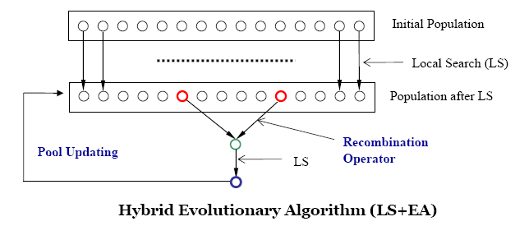
Memetic Algorithm
Hybrid Evolutionary Algorithm = Memetic Algorithm
Difference with EA algorithms:
  Smaller population (20 to 30) with elite solutions
  Semantic recombination operator ---- big jump
  Pool Updating (population diversity is very important!)

Slide 82
Sum Up
Highlights to design a good metaheuristic algorithm:
  Select good neighborhood(s)
  Fast evaluation of neighborhood moves
  Tradeoff between Intensification and Diversification
    Select appropriate search strategies
    Combination of neighborhoods
    Combination of search strategies
  Semantic/problem specific operators
  Using memory and history in the search
  Always consider problem structure anywhere

Slide 83
Sex and Metaheuristic Metaphors
In short, Courtship Algorithms provide a natural foundation for developing new metaheuristic processes. To inform such processes, it is possible to formulate a collection of Key Strategic Principles, as embodied in time-honored expressions that people have applied to courtship.

Slide 84
Sex and Metaheuristic Metaphors
Have we met before? (Use memory to exploit recurrences.)
Variety is spice. (Employ diversification at all levels.)
Try it, you'll like it. (Experiment and probe beyond the surface.)
Opposites attract. (Join diversification (via opposites) and
intensification (via attraction).)
Familiarity breeds … (Watch for important affinities.)

Slide 85
Sex and Metaheuristic Metaphors
When in Rome … (Adapt to the terrain.)
Once is not enough. (Iterate over good options.)
Play the field. (Don’t be restricted to a single move or strategy.)
Two’s company, three’s a crowd. (Sometimes paired combinations work well.)
Ménage à trois (And sometimes it can be worthwhile to go beyond pairs.)
The more the merrier. (And then sometimes …)

Slide 86
Sex and Metaheuristic Metaphors
Am I getting warmer? (Test the setting to determine the next move.)
Don’t stop now! (Take advantage of momentum.)
Be gentle. (But do so prudently.)
Be prepared. (Initial strategies can set the stage for later ones.)
Let’s compare our … (Discover advantageous similarities and differences.)
Be selective. (Sift through options.)

Slide 87
Sex and Metaheuristic Metaphors
Don’t leave things to chance. (Random behavior can sometimes be counterproductive.)
No need to be timid. (Well-timed aggressive moves can pay off.)
Go with the moment. (Include short term strategies for congenial terrain.)
Trust your instincts. (Intuitive exploration can supplement strict analysis.)
We’ve got to stop meeting like this! (Introduce variation to avoid cycling traps.)

Slide 88
Sex and Metaheuristic Metaphors
The bar is closing. Let’s find someplace more interesting to go! (Establish limits and follow through with exploration of new terrain.)
If at first you don’t succeed, try, try again … (Restarting in new areas to find better results.)
May I offer you these flowers? (In case of dynamic or imprecise optimization: reevaluate)
Don't know whether I can propose another one. Let us try:
"Don't do _that_ again ... at least not immediately" (Tabu search)

Slide 89
Sex and Metaheuristic Metaphors
I'm not sure I'm ready for this. (Alternate between intensification and diversification strategies.)
”Do you have a sister?” (Neighborhood search may pay dividends.)
"Your brains and my beauty" (generate combinations based on different criteria, e.g. rigorous and esthetic, quantitative and qualitative).
Things are moving too quickly … (Don’t be afraid to be thorough.)

Slide 90
Thanks！

